Slide 1


Slide 2


Slide 3
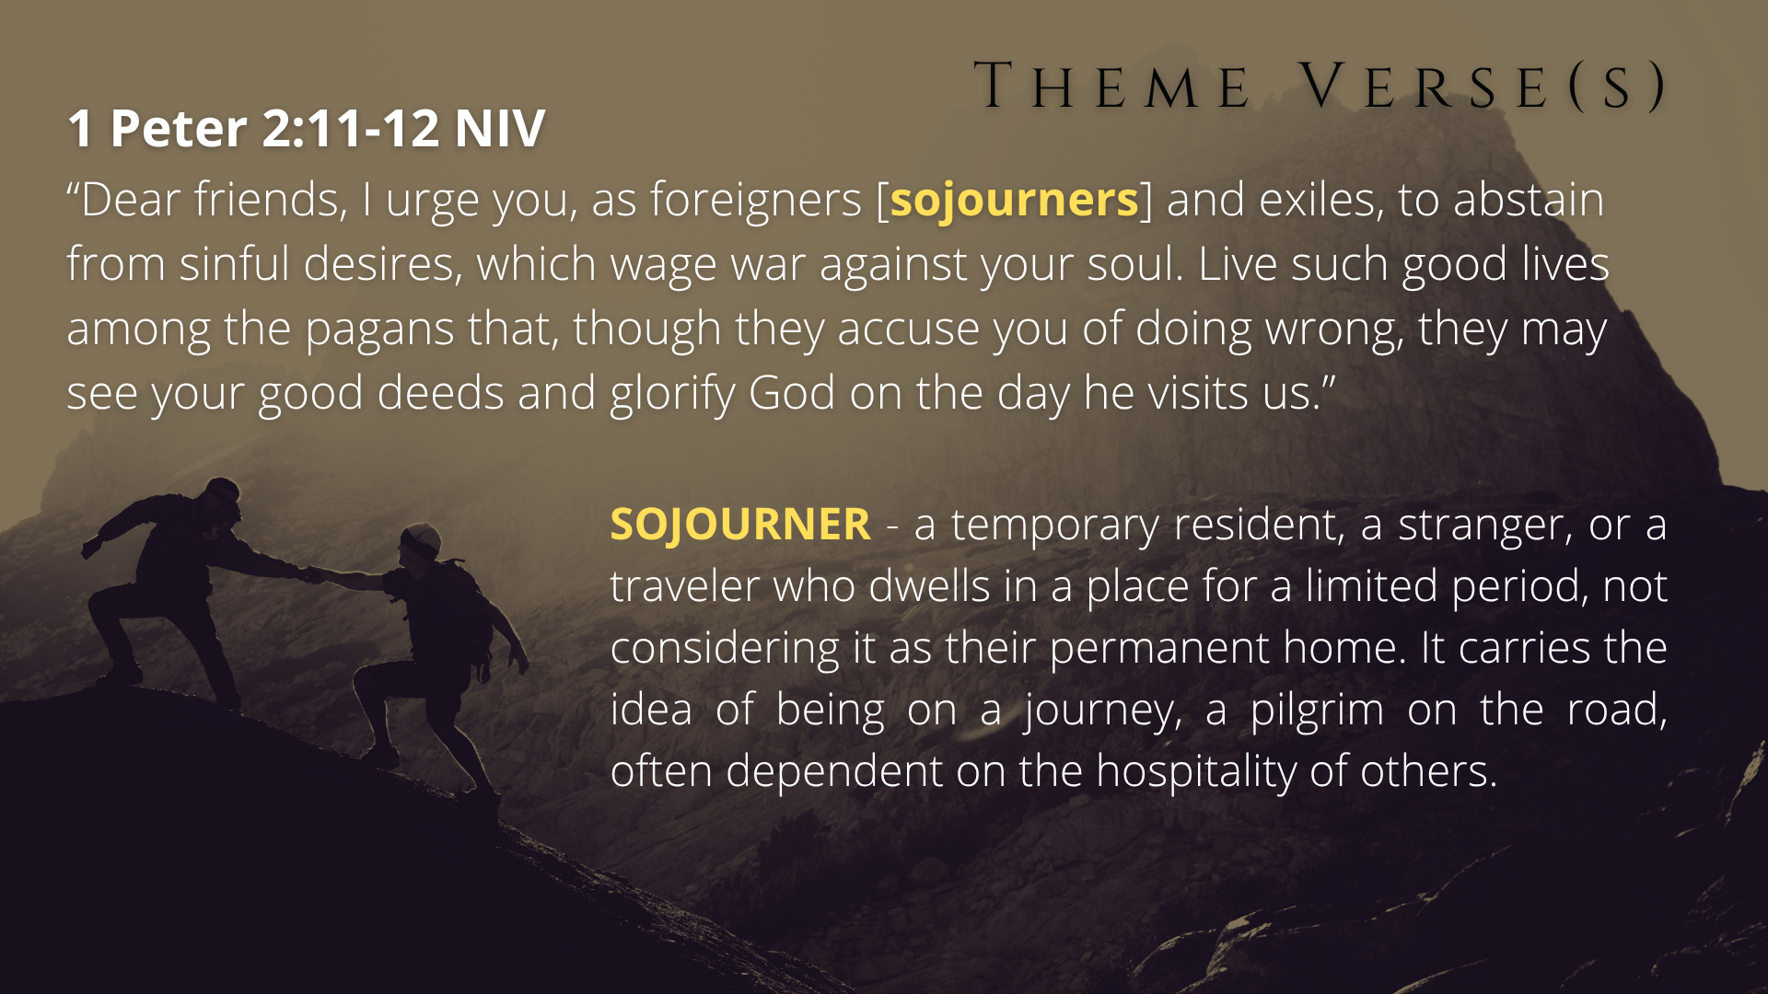

Slide 4


Slide 5
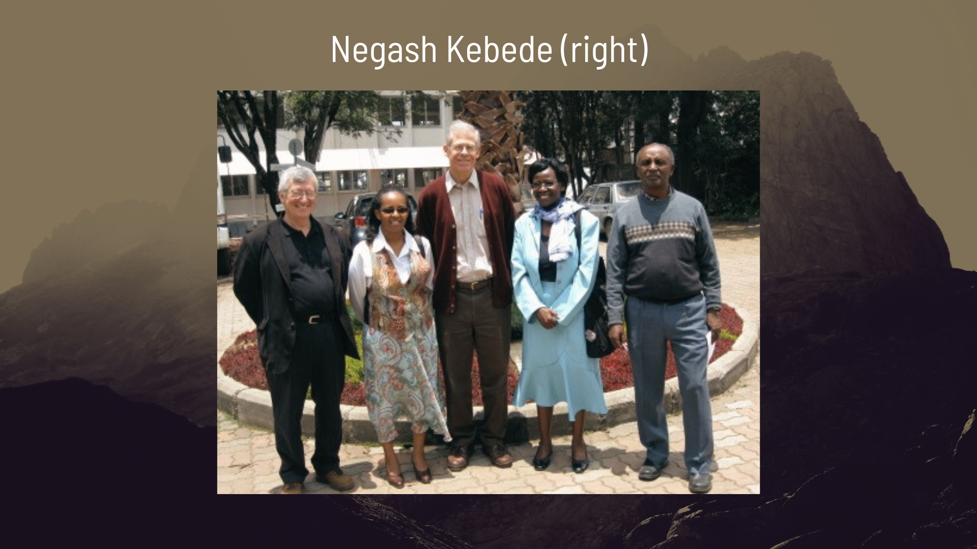

Slide 6
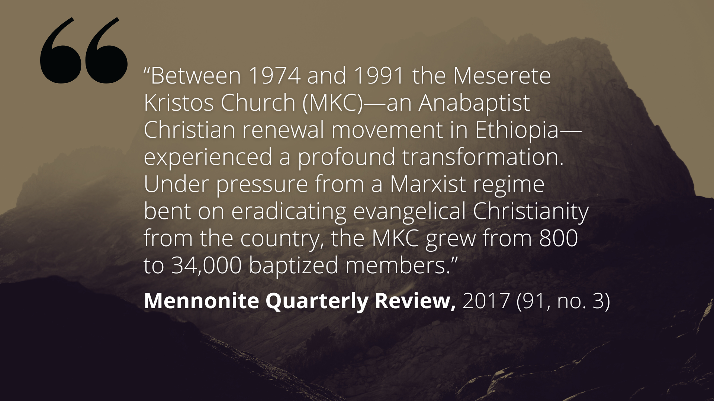

Slide 7
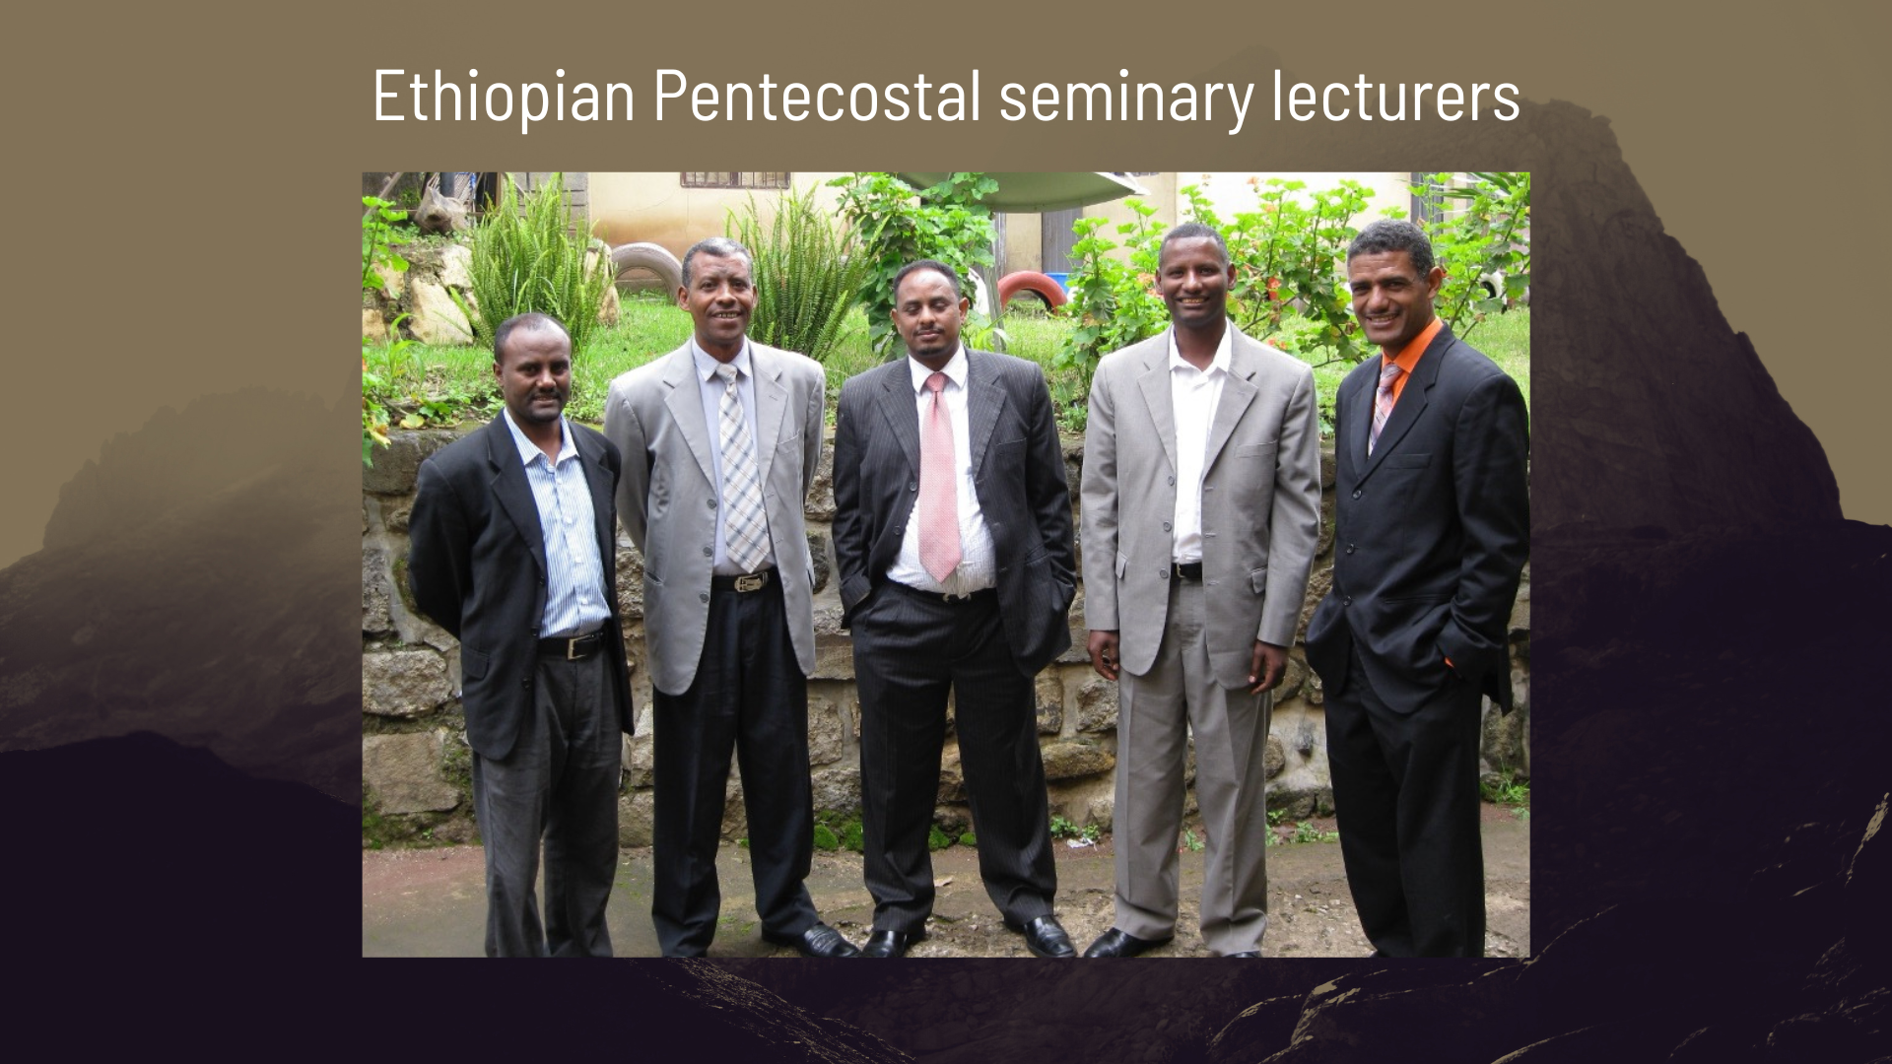

Slide 8
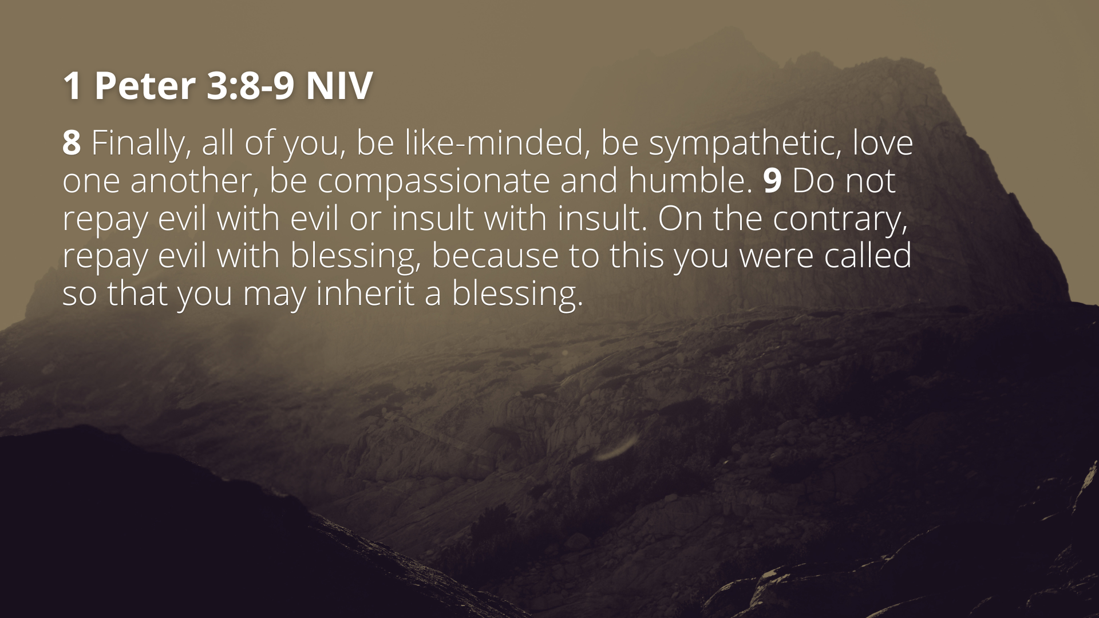

Slide 9
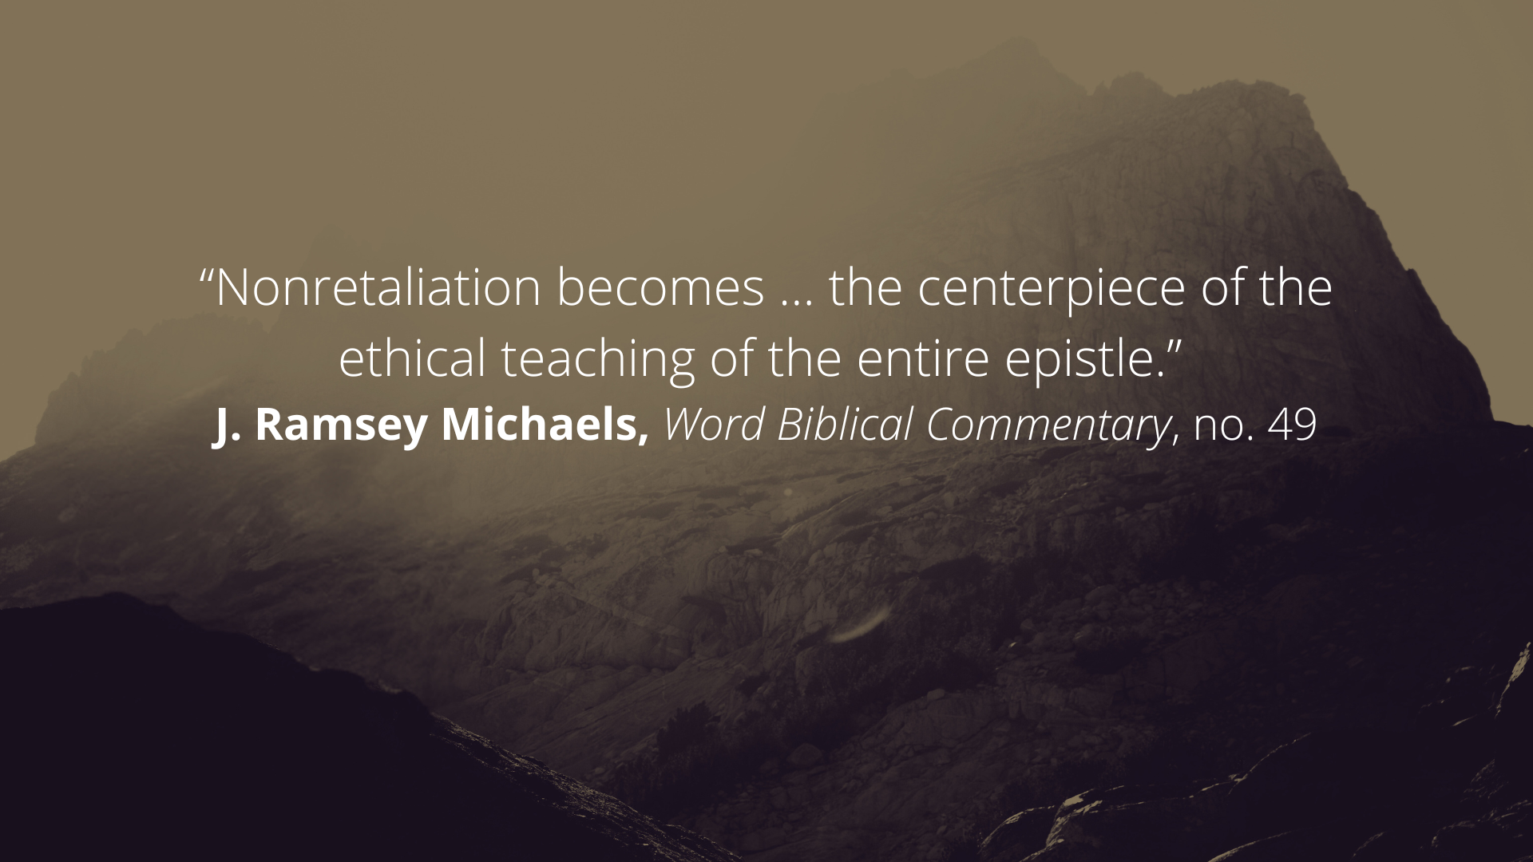

Slide 10
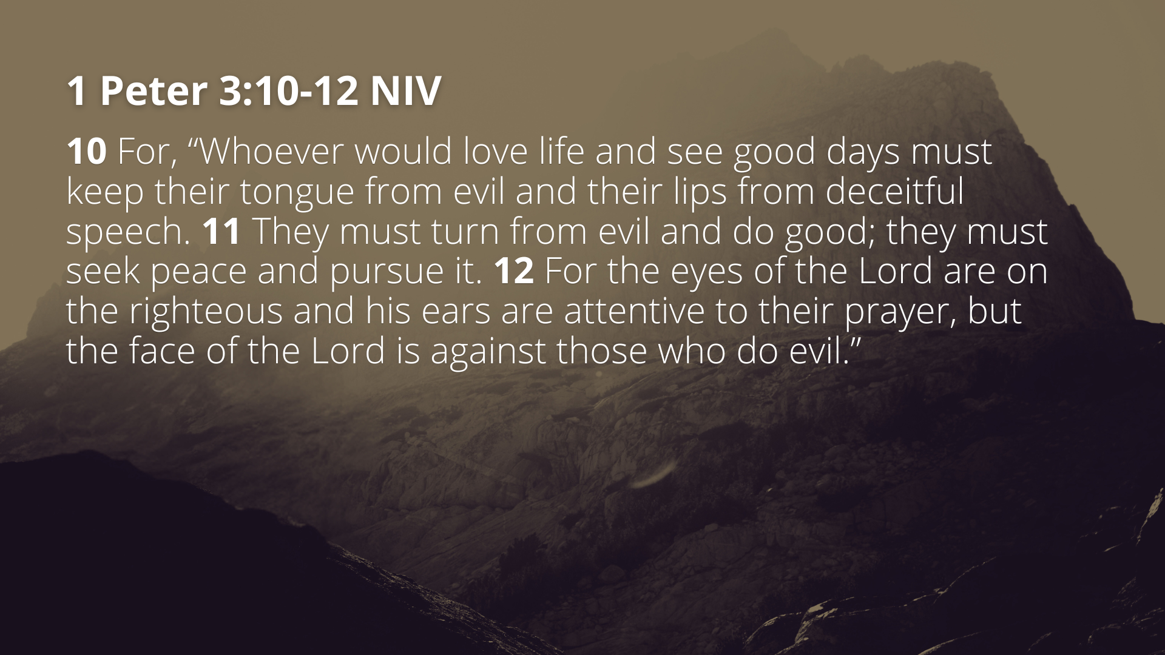

Slide 11
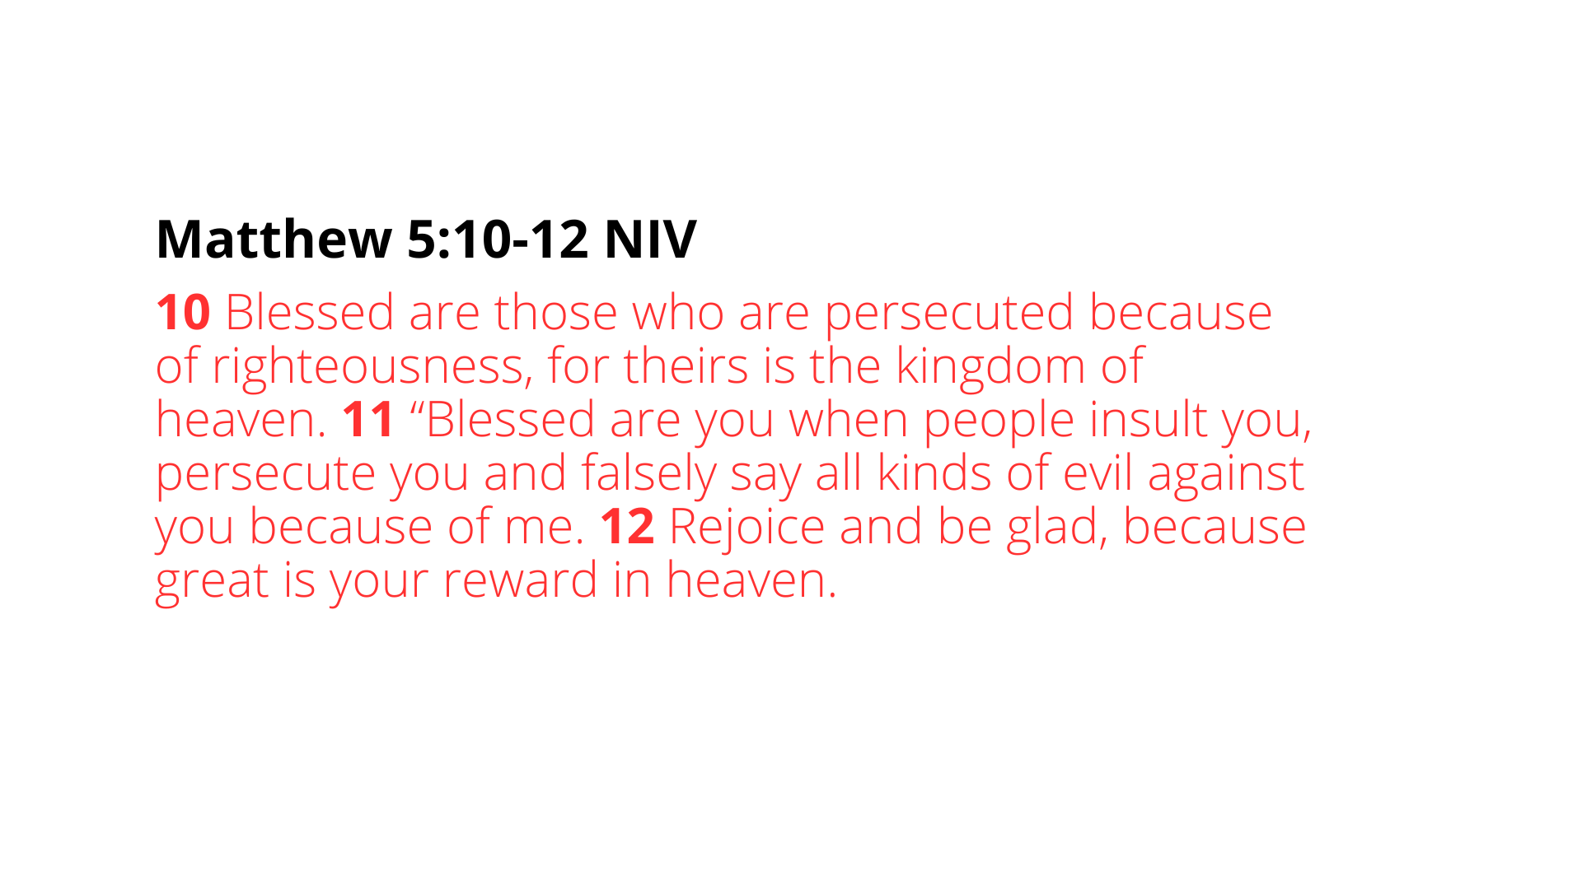

Slide 12
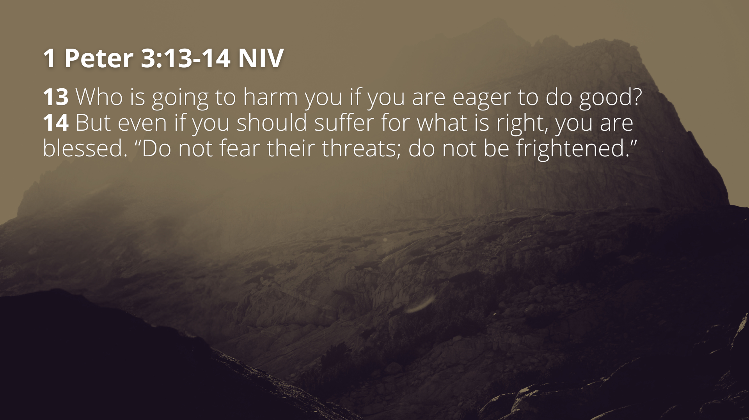

Slide 13
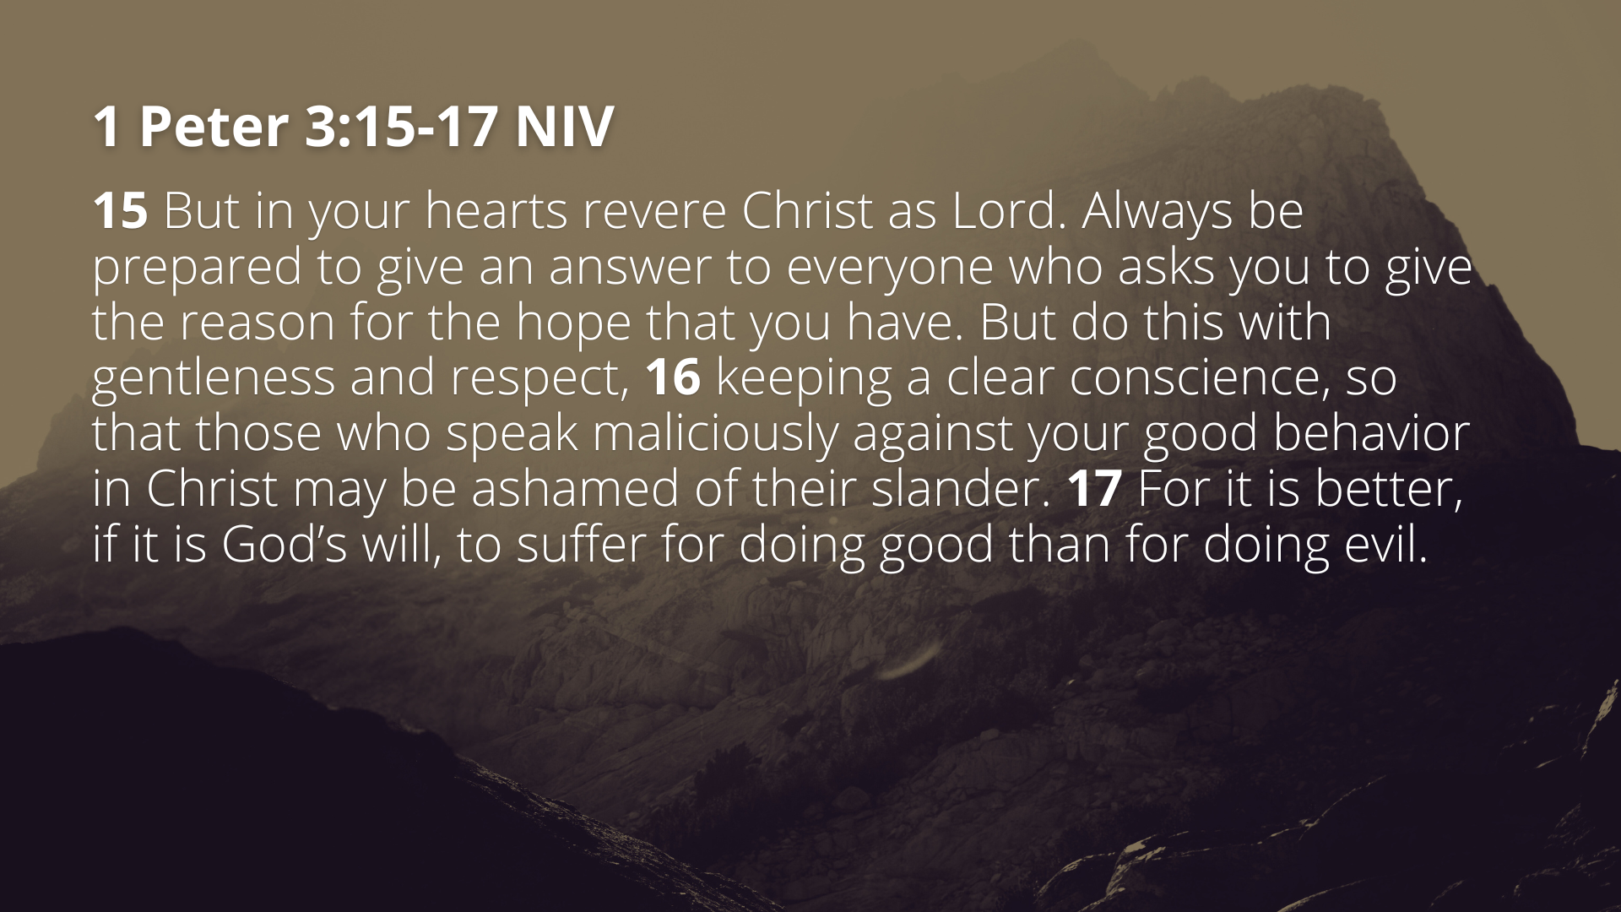

Slide 14
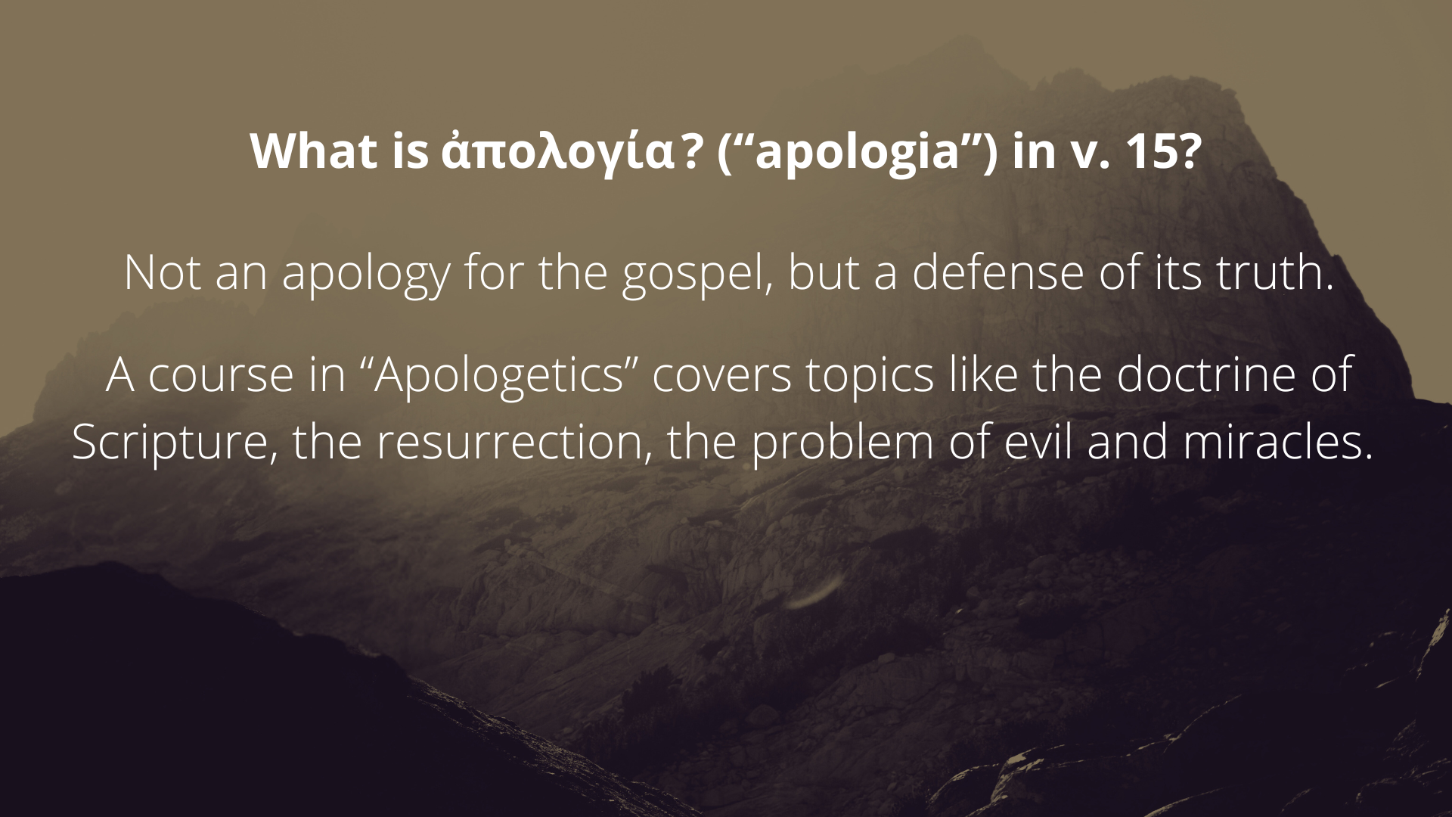

Slide 15


Slide 16
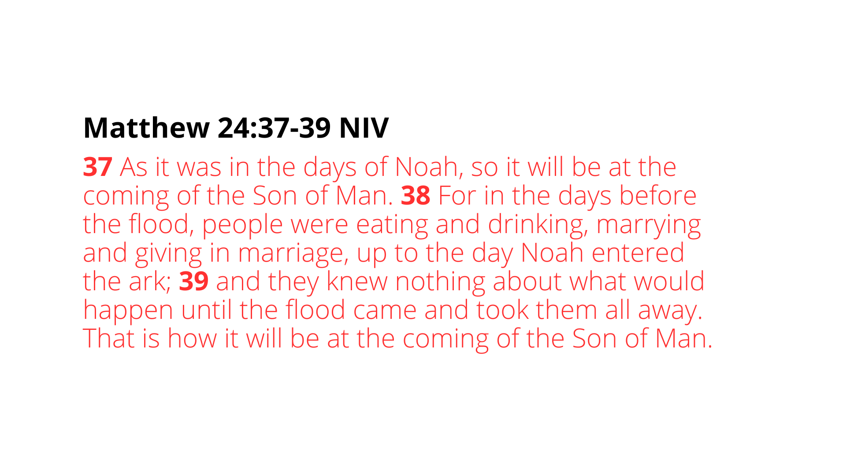

Slide 17
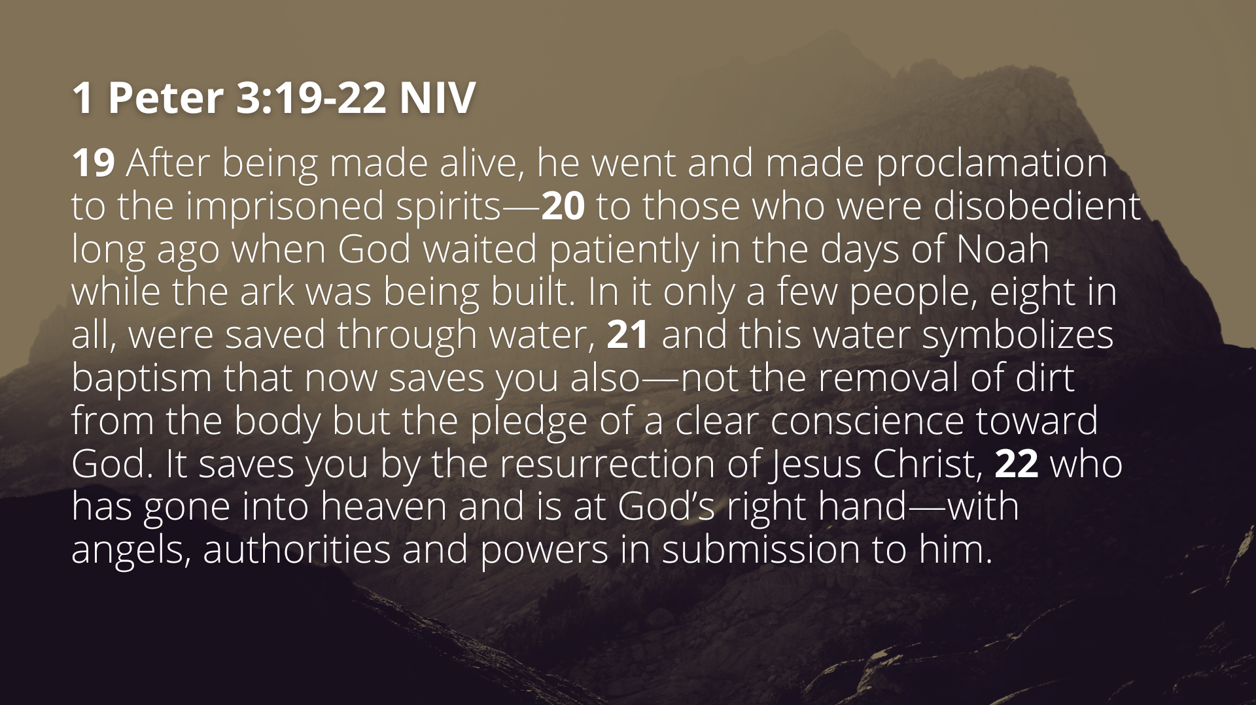

Slide 18
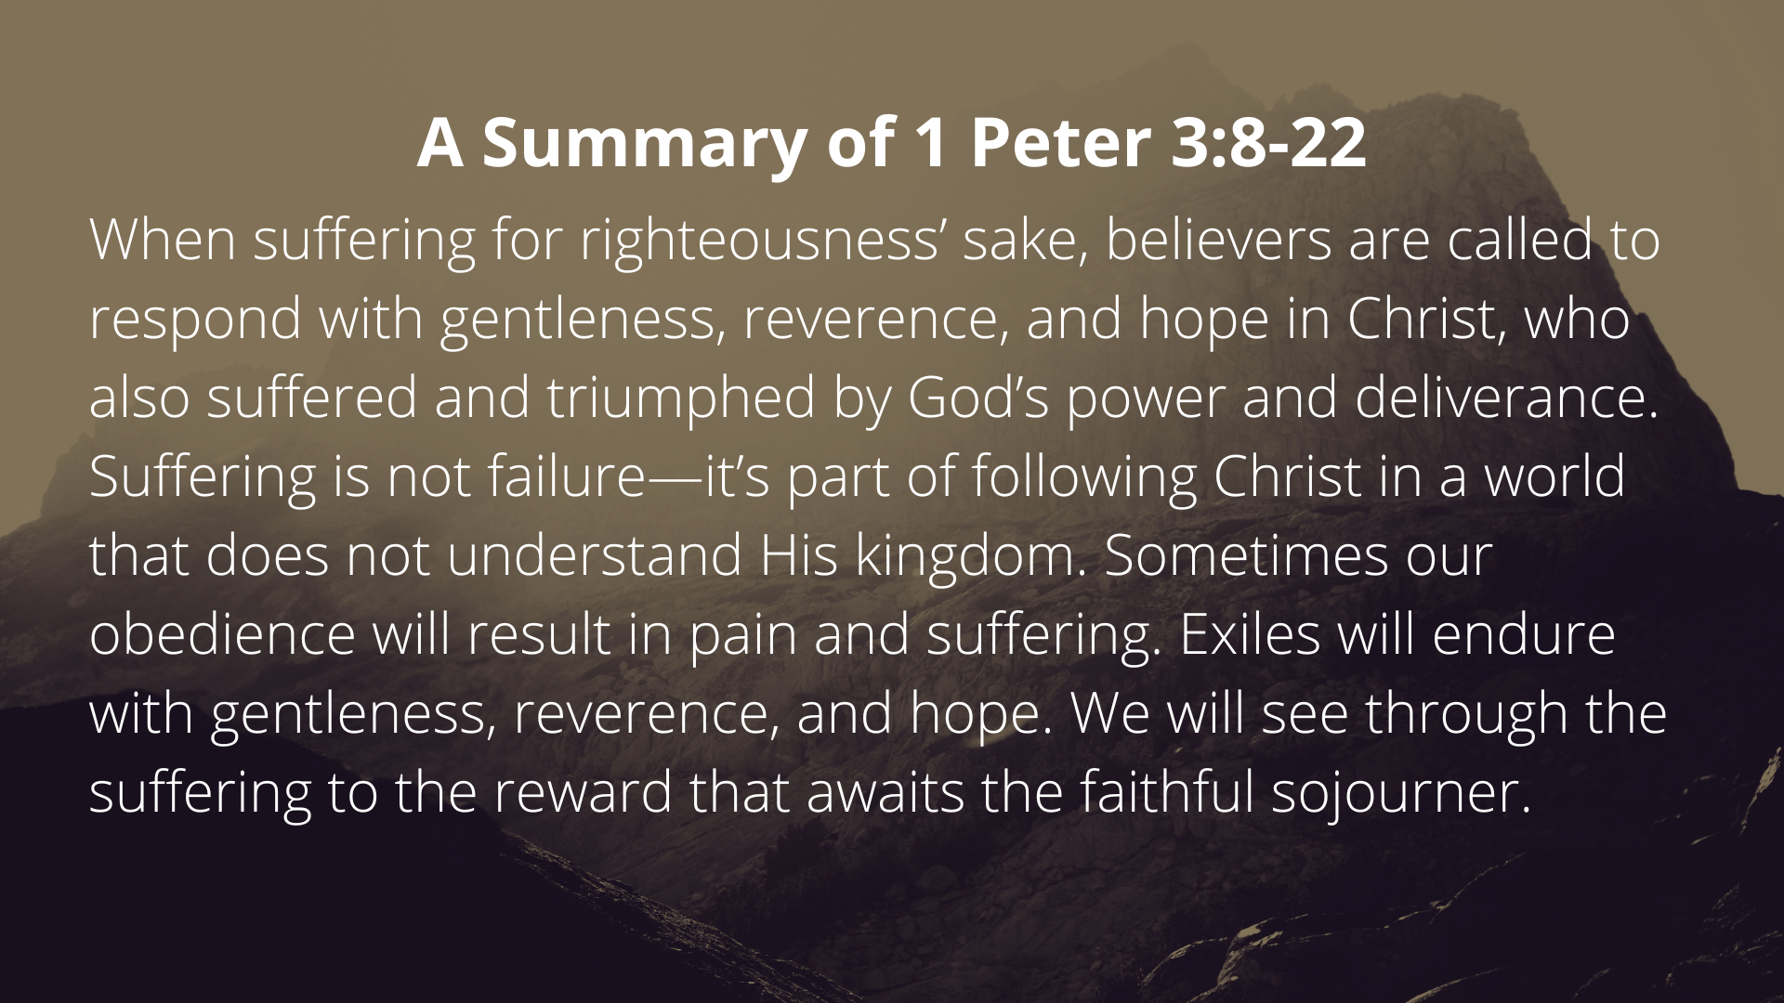

Slide 19


Slide 20
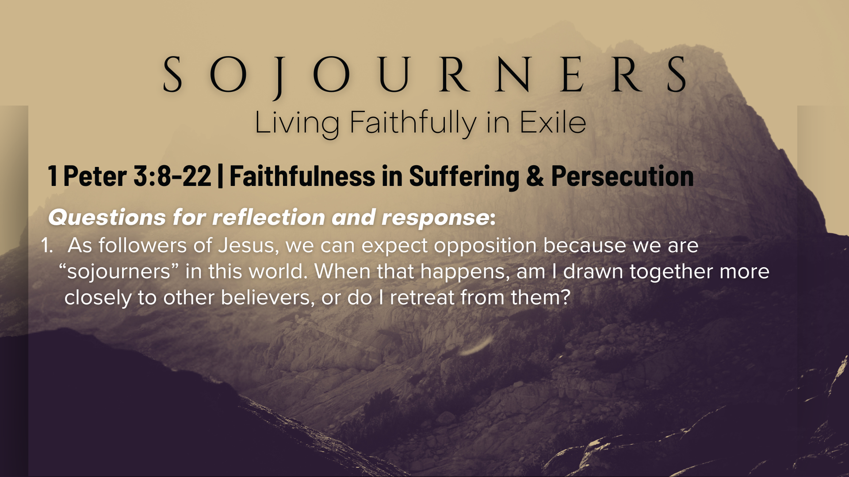

Slide 21
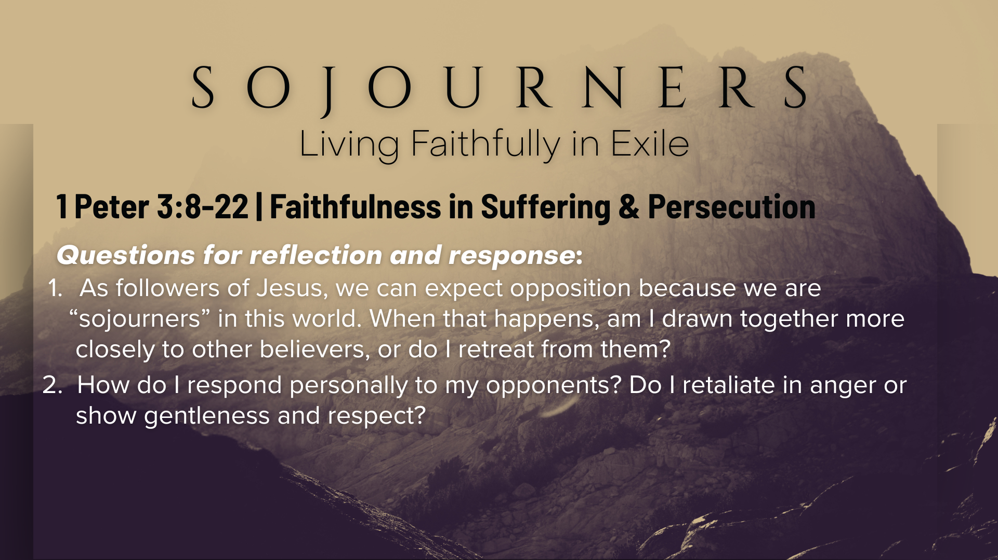

Slide 22
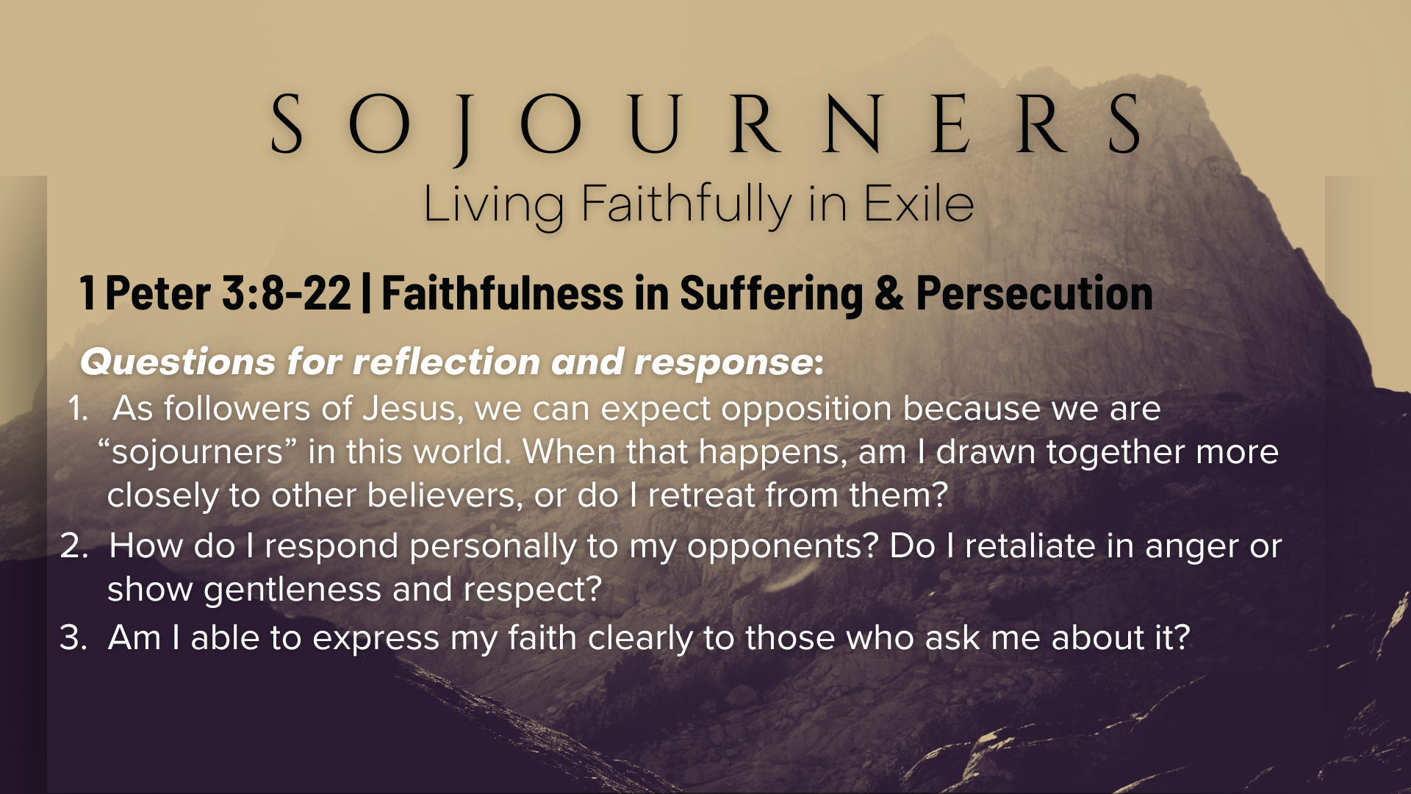

Slide 23
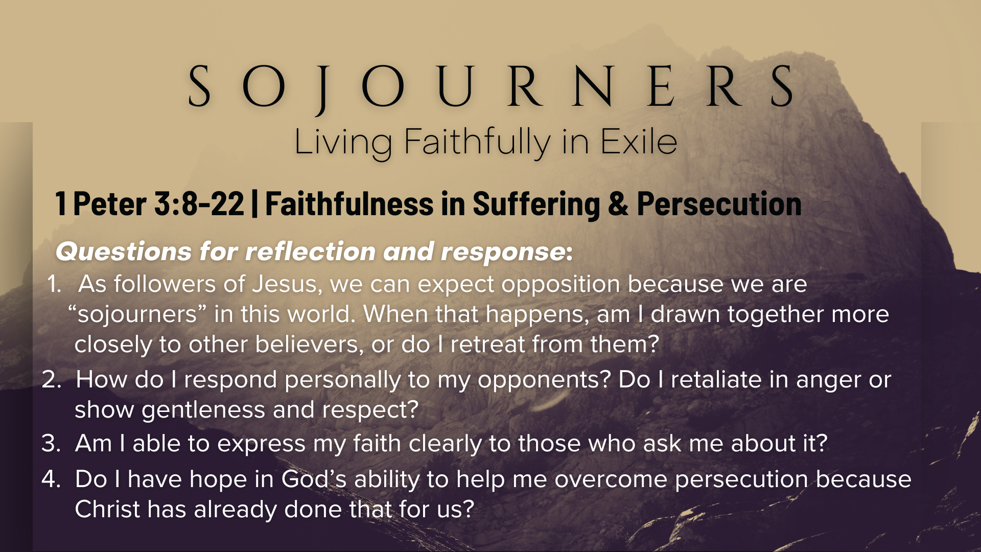

Slide 24

Notes:
[CLOSING PRAYER]
Benediction
Chosen people of God, as sojourners and exiles in this world,
set your hearts on the Living Hope – Christ risen and reigning.
As you go into the world,
may you walk in hope,
stand firm in God’s grace,
shine with the love of Jesus,
and allow the Spirit to sustain you in all things,
until the day your sojourning gives way to glory.
Go in peace, church,
and live faithfully in exile.
Amen.

